Slide 1
MUF SS19
KERAS Dense Layers

Slide 2

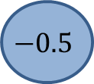

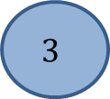

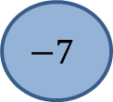

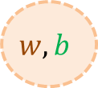

A dense layer in KERAS
myDenseLayer = Dense(1, input_shape=3)
Input
Vector of shape (3)
Output
Vectors of shape (1)
Activation Function
$$A(x) = x$$
$$3$$
$$w_{1}=−4$$
2
$$w, b$$
$$−7$$
-7
$$w_{2}=1$$
$$b=4$$
$$w_{3}=2$$
$$−0.5$$
$w^{T}x+b=\left(−4⋅3+1⋅2− 2⋅0.5\right)+4=−7$
$φ(w^{T}x+b$) = $w^{T}x+b=−7$

Slide 3
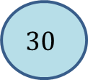
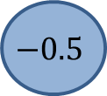
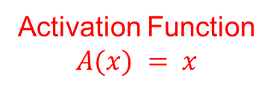
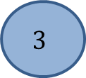
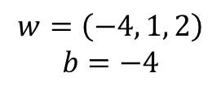
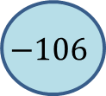



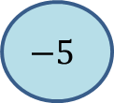
A dense layer in KERAS
Input
Vector of shape (*,3)
Output
Vectors of shape (*,1)
1
2
Activation Function
$$A(x) = x$$
$$30$$
$$3$$
1
$$w=\left(−4, 1, 2\right)$$
$$b=−4$$
1
2
20
2
$$w, b$$
$$−106$$
-7
2
3
$$−5$$
$$−0.5$$
$w^{T}x+b=\left(−4⋅3+1⋅2− 2⋅0.5\right)+4=−7$
A$(w^{T}x+b$) = $w^{T}x+b=−7$
$w^{T}x+b=\left(−4⋅30+1⋅20− 2⋅5\right)+4=−106$
$A(w^{T}x+b$) = $w^{T}x+b=−106$

Slide 4
What is a Dense Layer?

Slide 5
Exercise in KERAS

Slide 6
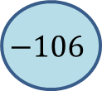
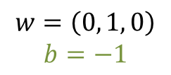
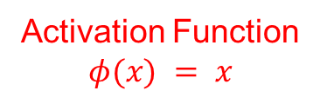
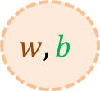

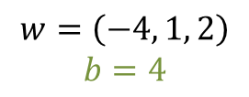


A Dense Layer in KERAS
Activation Function
$$φ(x) = x$$
$$30$$
$$3$$
$$w, b$$
$$w=\left(−4, 1, 2\right)$$
$$b=4$$
$$−106$$
-7
20
2
$$w, b$$
$$w=\left(0, 1, 0\right)$$
$$b=−1$$
19
1
$$−5$$
$$−0.5$$
$w^{T}x+b=\left(−4⋅3+1⋅2− 2⋅0.5\right)+4=−7$
$φ(w^{T}x+b$) = $w^{T}x+b=−7$
$w^{T}x+b=\left(−4⋅30+1⋅20− 2⋅5\right)+4=−106$
$φ(w^{T}x+b$) = $w^{T}x+b=−106$

Slide 7

Dense Layer as Matrix-Multiplication (ignore Activation for a moment)
$$X= \left(\begin{matrix}3 & 3 & −0.5 & 1 \\ 30 & 20 & −5 & 1\end{matrix}\right), X∈ ℝ^{n×(d+1)}$$
$W = \left(\begin{matrix}−4 & 0 \\ 1 & 1 \\ 2 & 0 \\ 4 & −1\end{matrix}\right), W∈ ℝ^{\left(d+1\right)×l}$
$X⋅W= \left(\begin{matrix}3 & 2 & −0.5 & 1 \\ 30 & 20 & −5 & 1\end{matrix}\right)⋅$ $\left(\begin{matrix}−4 & 0 \\ 1 & 1 \\ 2 & 0 \\ 4 & −1\end{matrix}\right)$ = $\left(\begin{matrix}−7 & 1 \\ −106 & 19\end{matrix}\right)$

Slide 8
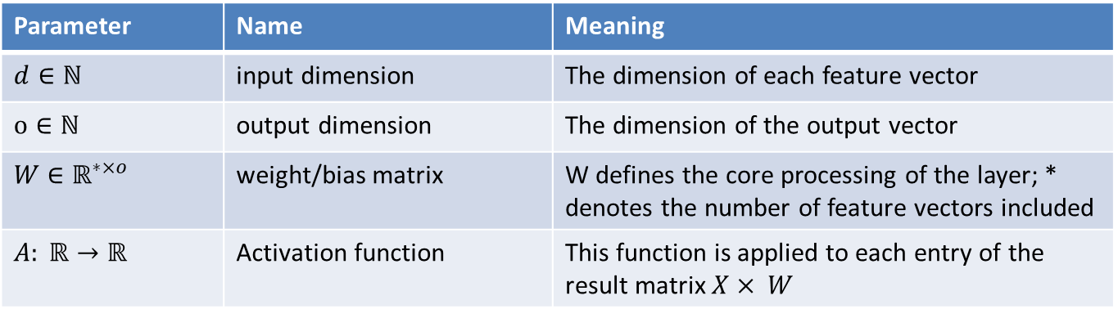
Dense Layer
A Dense Layer at this stage is defined by the following parameters:
Parameter | Name | Meaning
$d∈ℕ$ | input dimension | The dimension of each feature vector
$$o∈ℕ$$ | output dimension | The dimension of the output vector
$W$ $∈ℝ^{∗×o}$ | weight/bias matrix | W defines the core processing of the layer; * denotes the number of feature vectors included
$$A: ℝ→ℝ$$ | Activation function | This function is applied to each entry of the result matrix $X× W$

